Slide 1
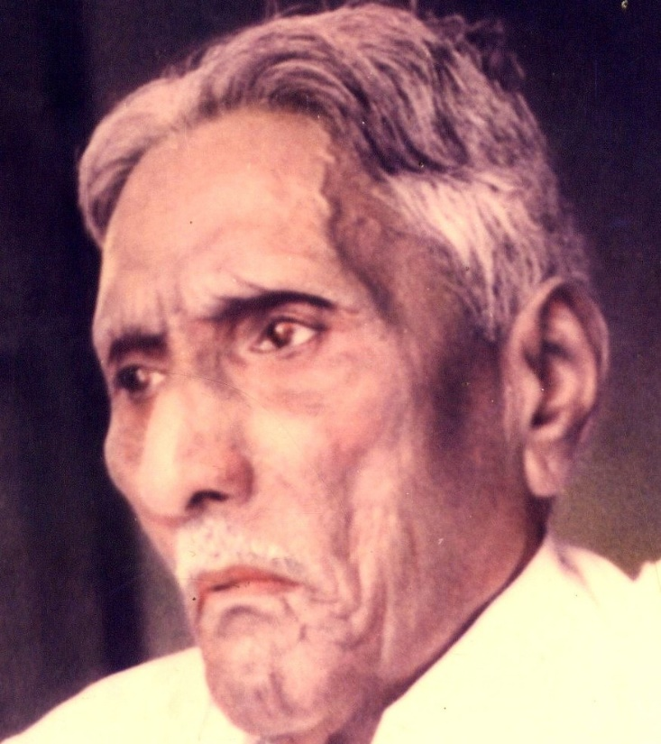

The Bible Mission The Revelation of God to St. M. Devadas The Bible Mission’s Annual Conference

Slide 2
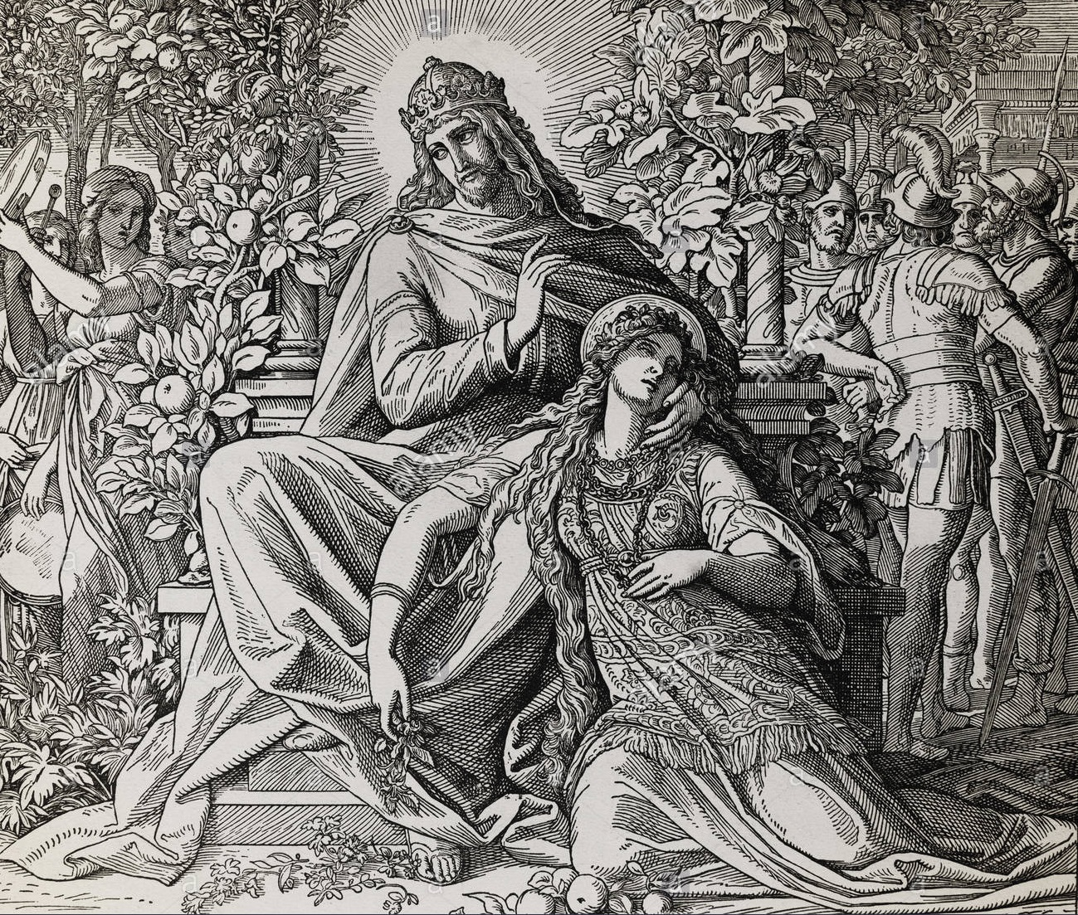
Persecution : The Perfection of Bride The Persecuted Bride in the song of Solomon

Slide 3
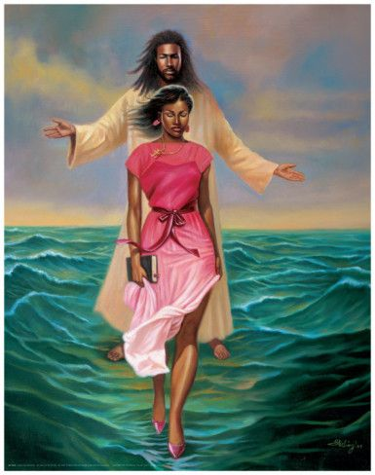
1.Complexion, Confrontation (1:5) 2.Rejection, Repatriation (1:6) 3.Veil and travail (1:7)

Slide 4
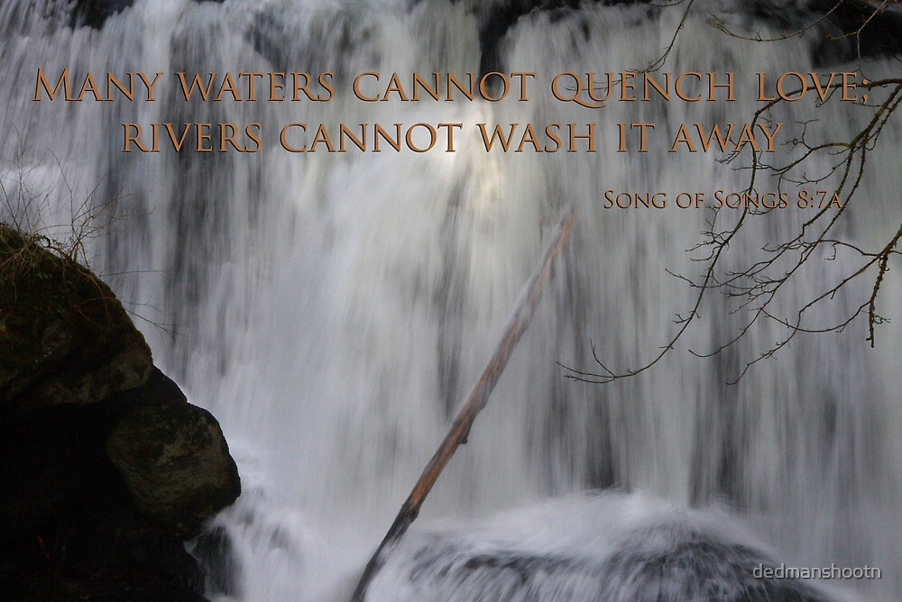
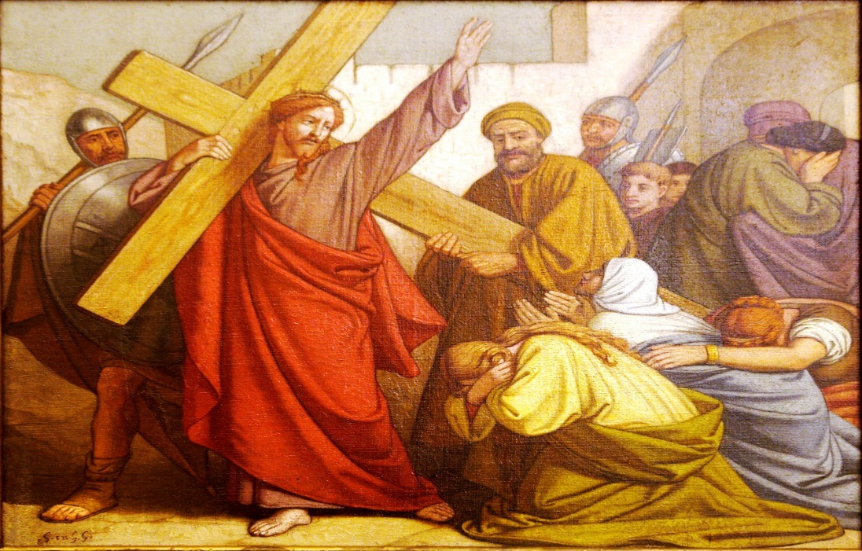
4.Scorn and Scoff (8:7) (8:1) ; 5.Disturbance caused by the daughters of Jerusalem (2:7) 6.The wall of obstruction (2:9)

Slide 5
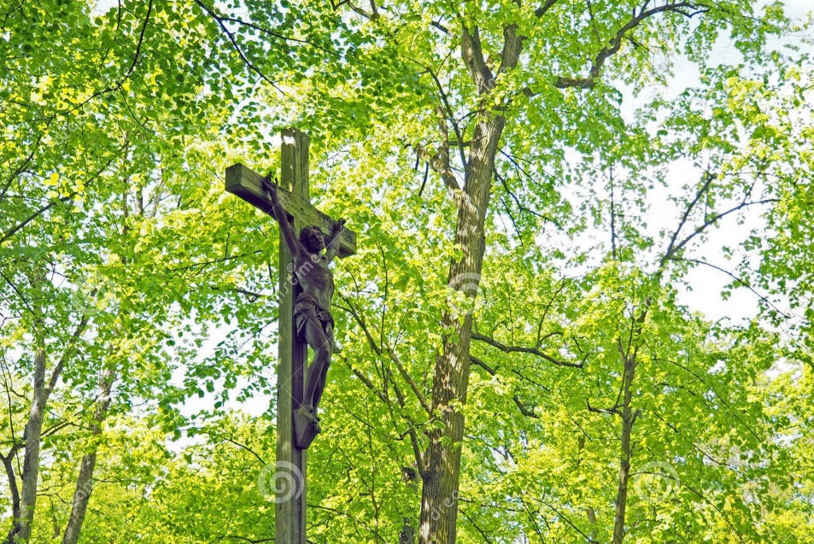
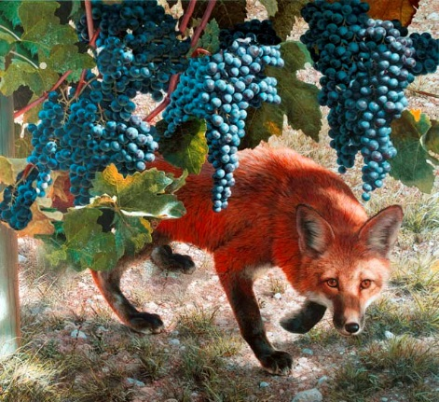
7.The season of stagnation (2:11) 8.The roots of destruction (Foxes and small foxes) (2:15) 9.The slumbers of night (3:1) (5:2);

Slide 6
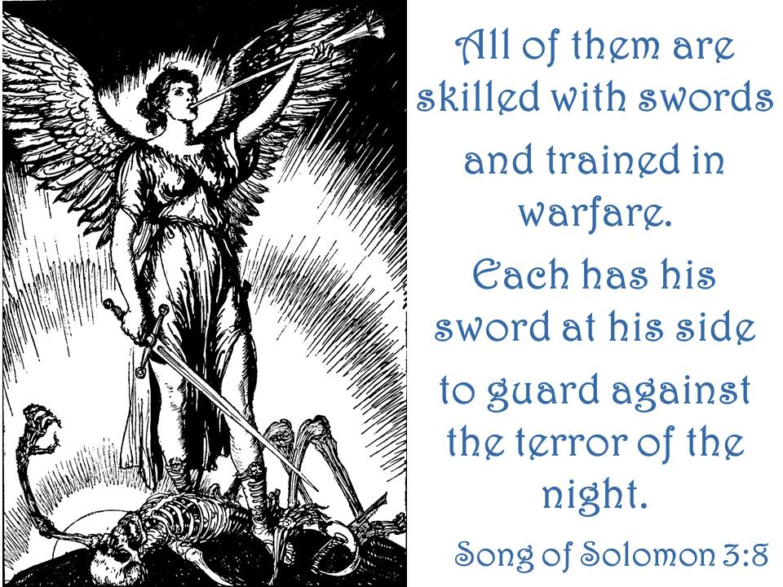
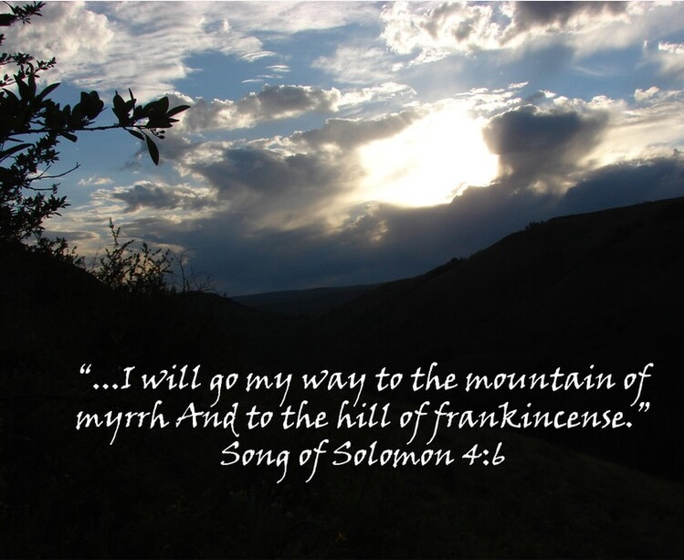
10.The scares of night (3:8) 11.The shadows of night (2:17) (4:6); 12.The season of irritation (4:6)

Slide 7
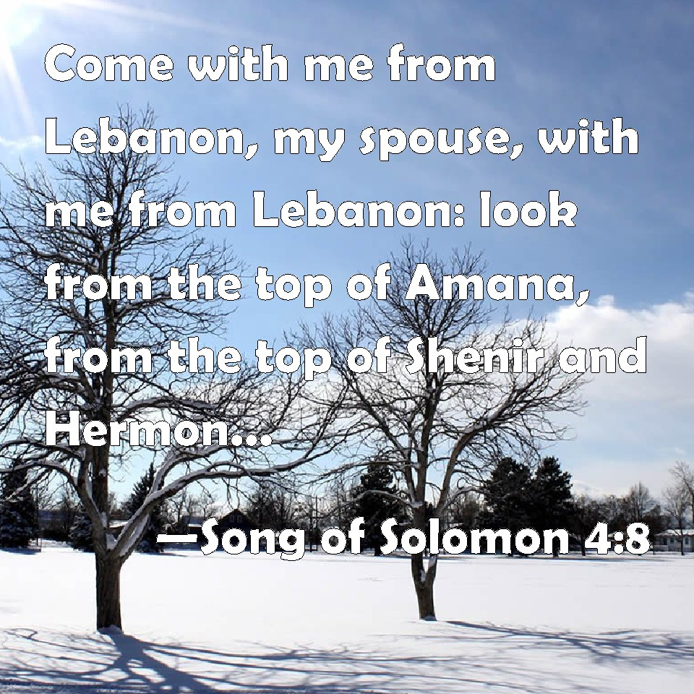
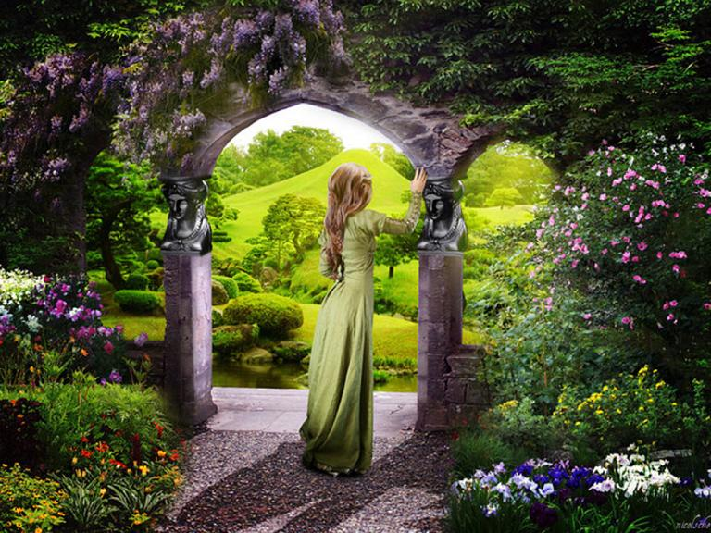
13.The season of hesitation (5:3) 14.The lofty mountains of Leopards and Lions dens (4:8) 15.The state of being sealed, enclosed and shut up (4:12)

Slide 8
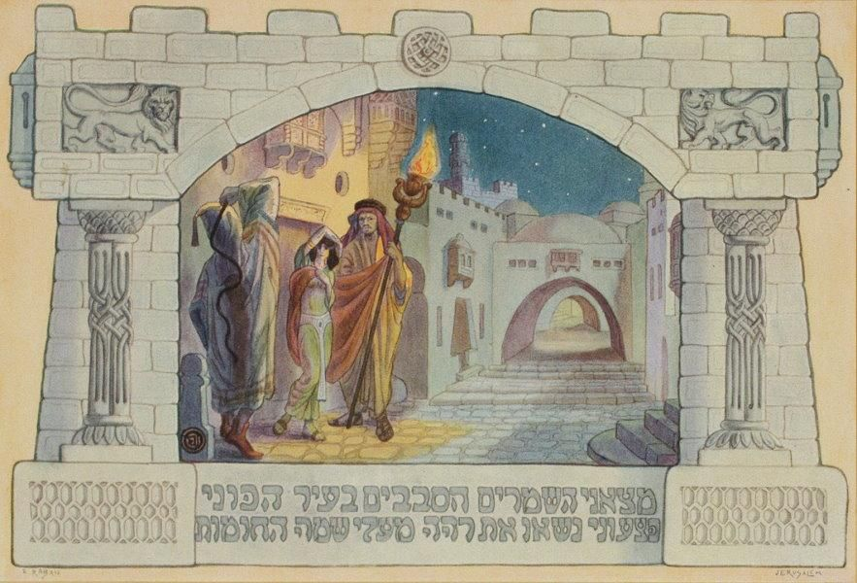
16.The state of being fainted (5:6) (2:5) 17.The hurting watchmen (5:7,8) 18.The stealing Keepers (5:7) ;

Slide 9
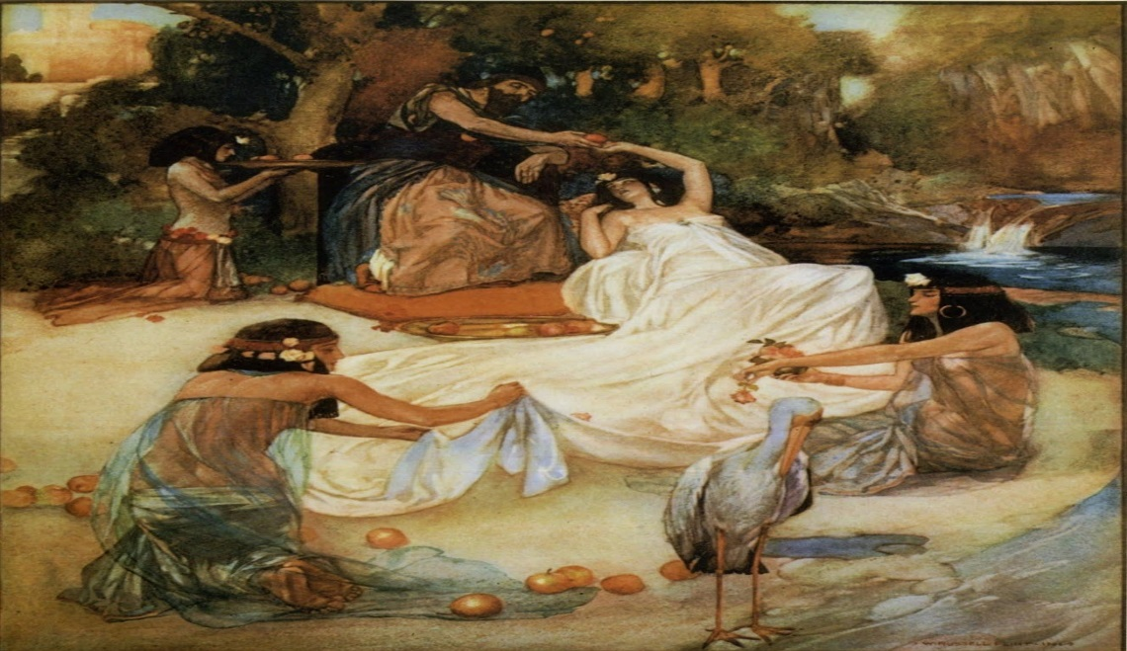
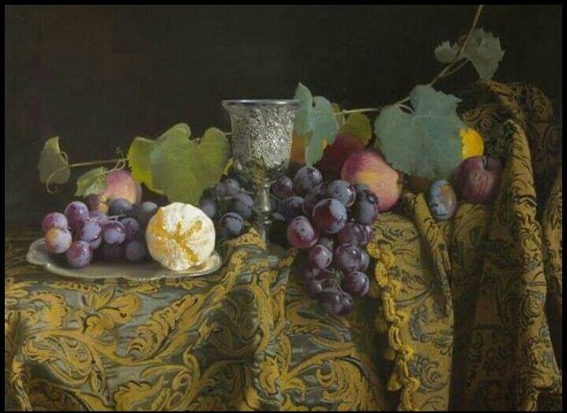
19.The season of birth pangs (8:5) 20.The deep waters (8:7) 21.The unripen fruits (7:13)

Slide 10
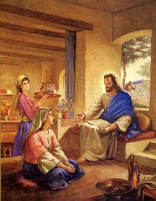
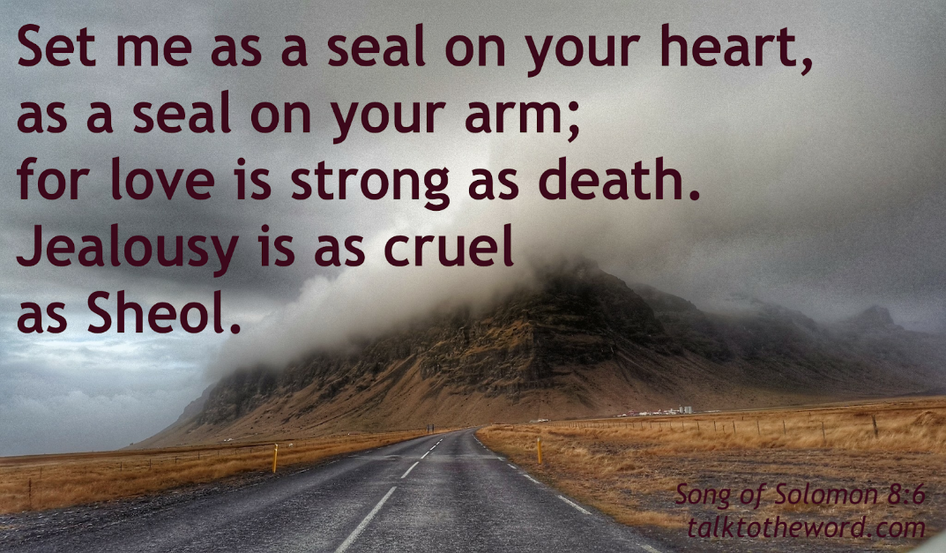
22.The immatured sister (8:8) 23.The raging flames (8:6)

Slide 11
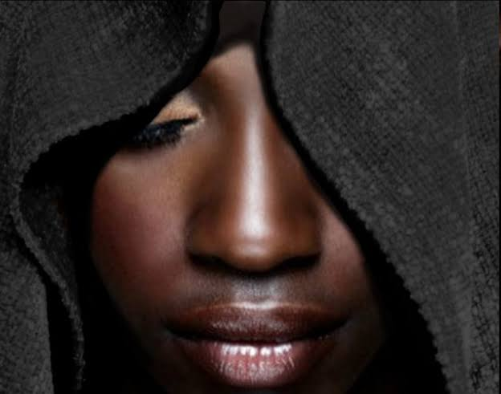
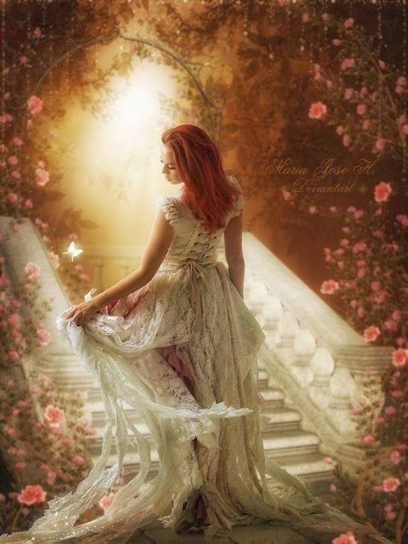
Persecution resulting in the perfection of the Bride in Song of Solomon
Persecution | Perfection
Dark Complexion | More Beautiful
Being Looked upon | Fairest among women
Tanned by the Sun | Fair as the Moon, Bright as the Sun

Slide 12
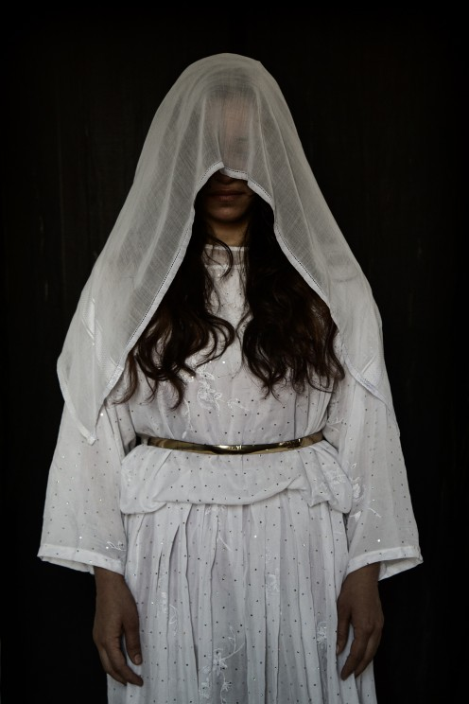
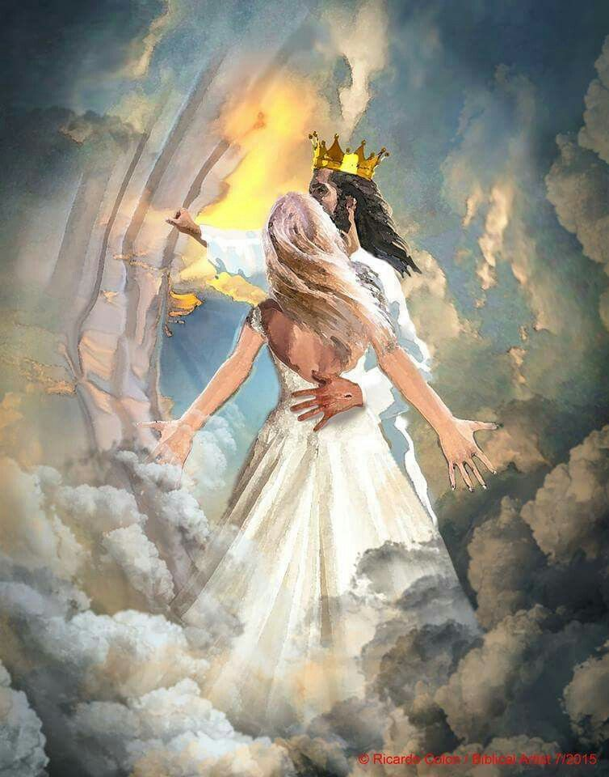
Persecution | Perfection
Anger of Brothers | Praised by the Queens
Keeper of vineyards | An Army with banners
Being veiled and made to wait | Being crowned like Mount Carmel
Being stirred up | Being carried in Solomon’s couch

Slide 13
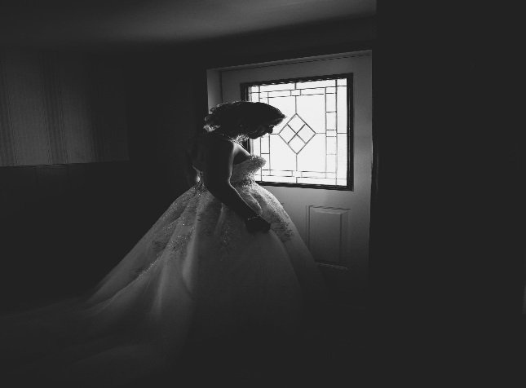
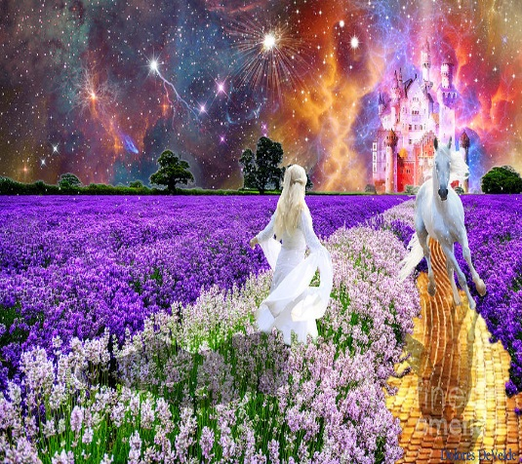
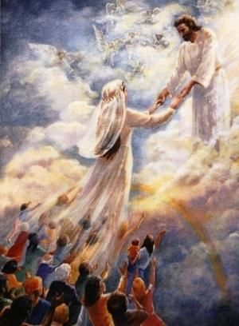
Persecution | Perfection
Winter stagnation | The singing of spring(season)
Foxes and little foxes that ruin vineyards | Pleasant fruits of all manner – New and Old
The slackness of night | Holding the Groom tight without letting him go again
The silent keepers (Un assisting) | Un Quenchable quest to find the Groom

Slide 14
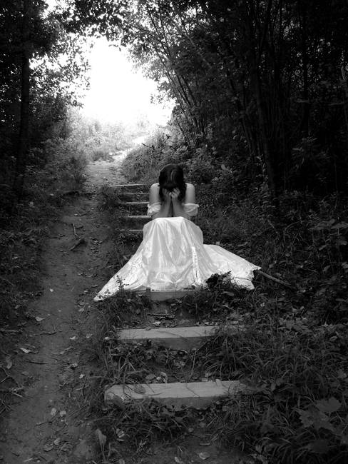
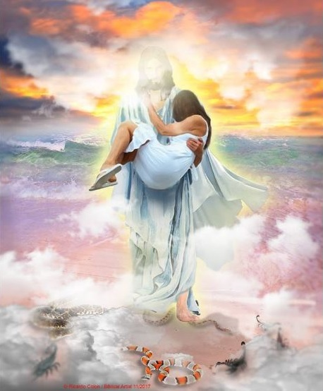
Persecution | Perfection
The scares of night | Being carried in the Couch
The Mountains of Leopards and the dens of Lions | Made as the chariots of Amminadab
Self – Debilities (Fraility 5 ,6) | Sustainable faith (Unconquerable) (6:3)

Slide 15
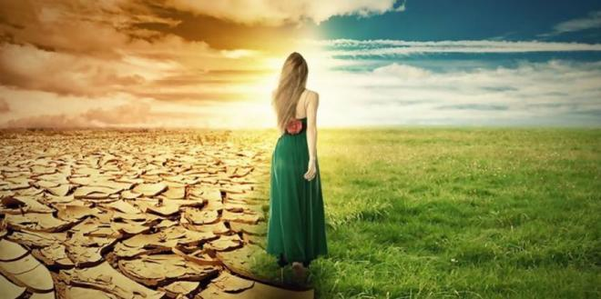
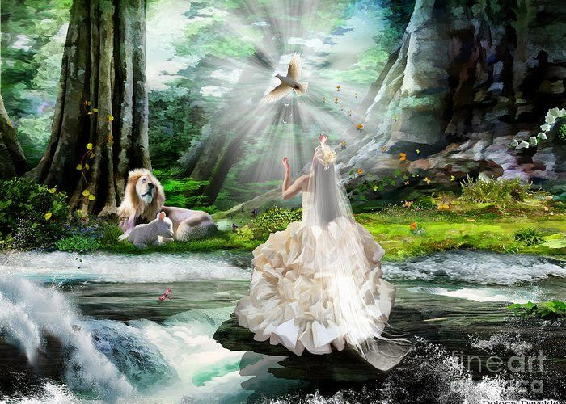
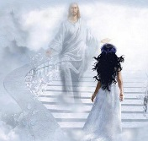
Persecution | Perfection
Blows and wounds | Fair and Pleasant with all the delights.
Being despised (8:1) | 17.Unique state; The only one ; The dearest one (6:9)
Birth pangs (8:5) | To become multitudes (A Holy Nation and Royal Priesthood)

Slide 16
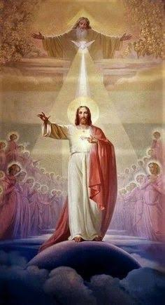
May the Holy Spirit Father Bless and Establish all of us to be His Bride.
AMEN

